Slide 1
Entity Framework Dot Net Core

Slide 2
Scaffold
Scaffold-DbContext "Server=(local);user=nook;password=1234;Database=NORTHWND;Trusted_Connection=True;" Microsoft.EntityFrameworkCore.SqlServer -OutputDir Models –Tables Customers,Orders,"Order Details",Products

Slide 3
Link
https://docs.microsoft.com/en-us/ef/core/get-started/aspnetcore/existing-db

Slide 4
LINQ
Lamda
(params) => {statements}
Query
from cust in db.customers where cust.City == "London" select cust;

Slide 5
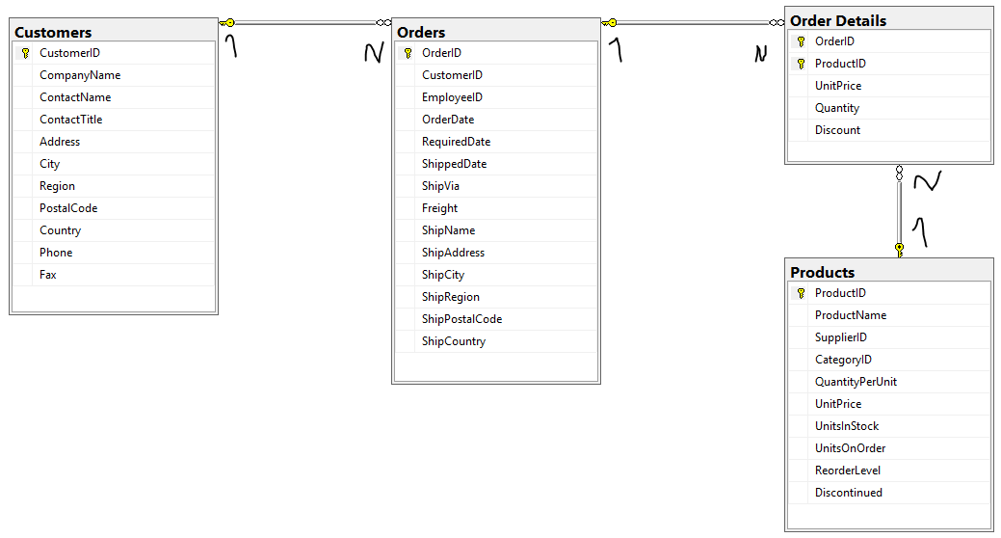
Northwind database
From https://northwinddatabase.codeplex.com/

Slide 6
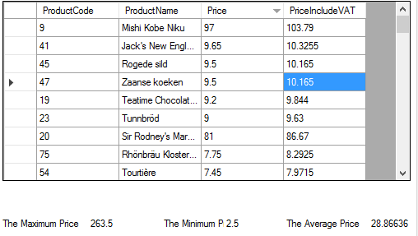
Assignment
Using NORTWIND Database to query.
In this assignment query from Product table.
1.) What SQL ?
What SQL ?
2) Max Price
3) Min Price
4) Average Price

Slide 7
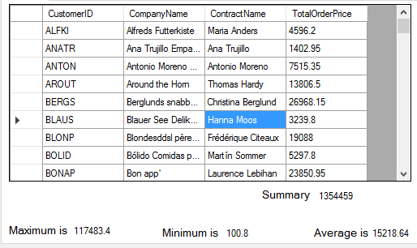
Advance Assignment
Using NORTWIND Database to query.
In this assignment query from Product table and relate table.
1.) What SQL ?
(TotalOrderPrice = Quantity * UnitPrice)
What SQL ?
2) Max TotalOrderPrice
3) Min TotalOrderPrice
4) Average TotalOrderPrice
5) Sum TotalOrderPrice

Slide 8
You can also split your content
White
Is the color of milk and fresh snow, the color produced by the combination of all the colors of the visible spectrum.
Black
Is the color of coal, ebony, and of outer space. It is the darkest color, the result of the absence of or complete absorption of light.

Slide 9
Thanks!
Any questions?
You can find me at @username & user@mail.me

